Slide 1

Problem Statement:
What are we going to do, and where does API fit into software/web development?

Slide 2
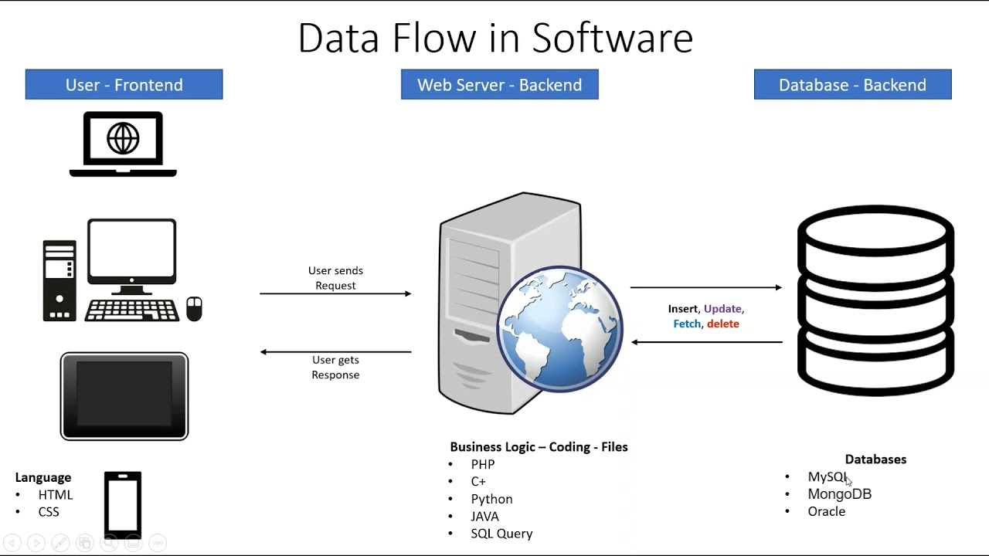

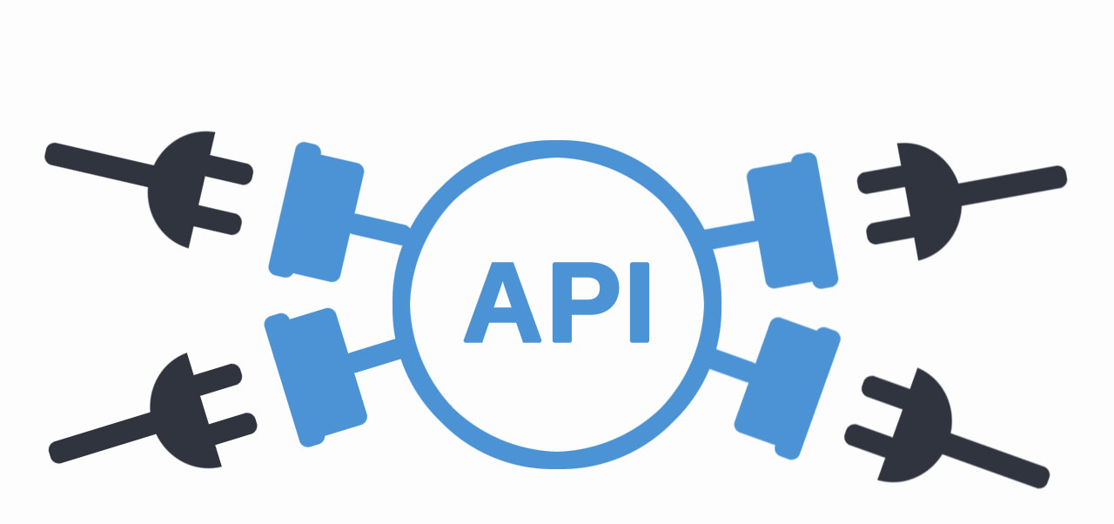


Slide 3
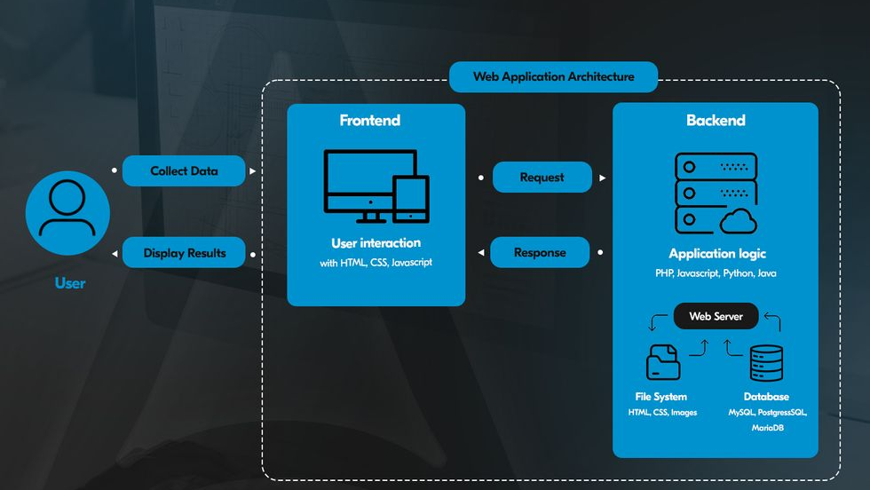

Slide 4
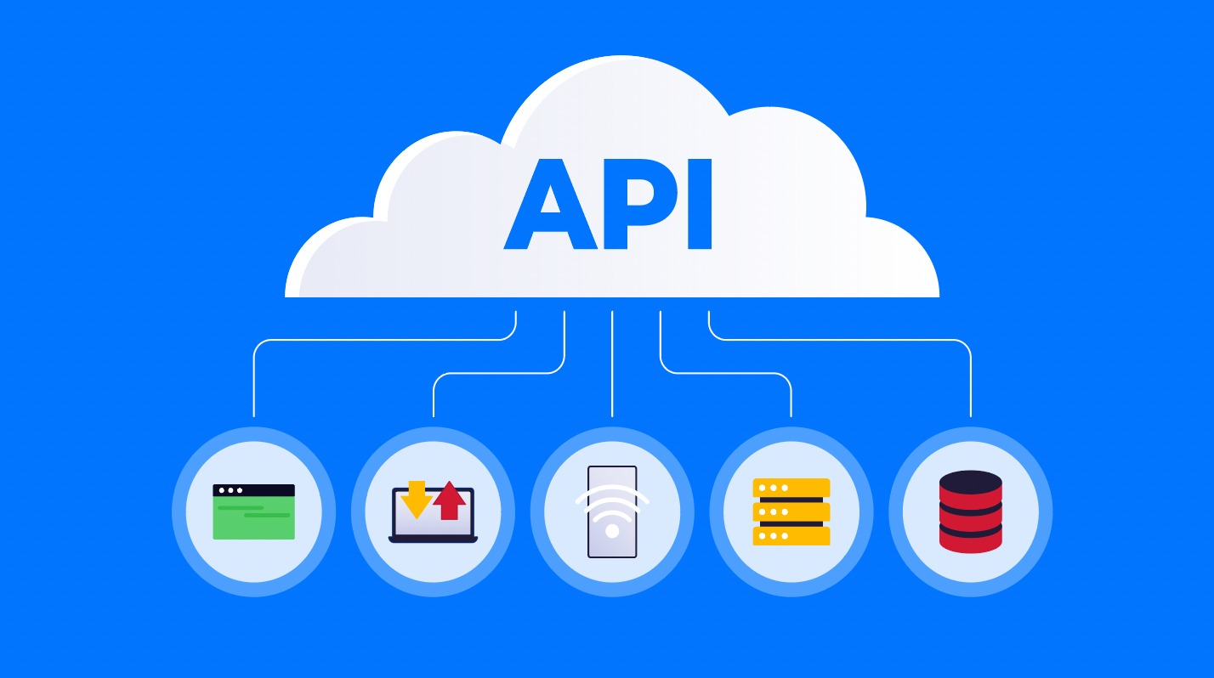

Slide 5
What is an API?
API (Application Programming Interface) is a set of rules and protocols that allows different software applications to communicate with each other. It defines how requests and responses should be structured, enabling seamless data exchange between systems.
Example: Ordering Food Using a Food Delivery App
When you use a food delivery app (like Zomato or Swiggy), you select a restaurant, pick your food, and place an order.
But the app itself doesn’t cook food — it talks to the restaurant’s system using an API.
How the API works:
The app sends your order details to the restaurant using an API.
The restaurant’s system receives it, confirms the order, and sends a response back — all using API communication.

Slide 6
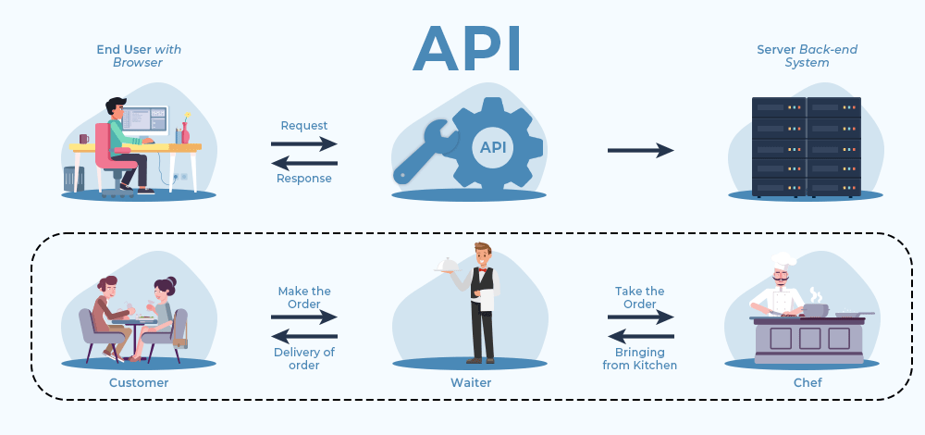

Slide 7
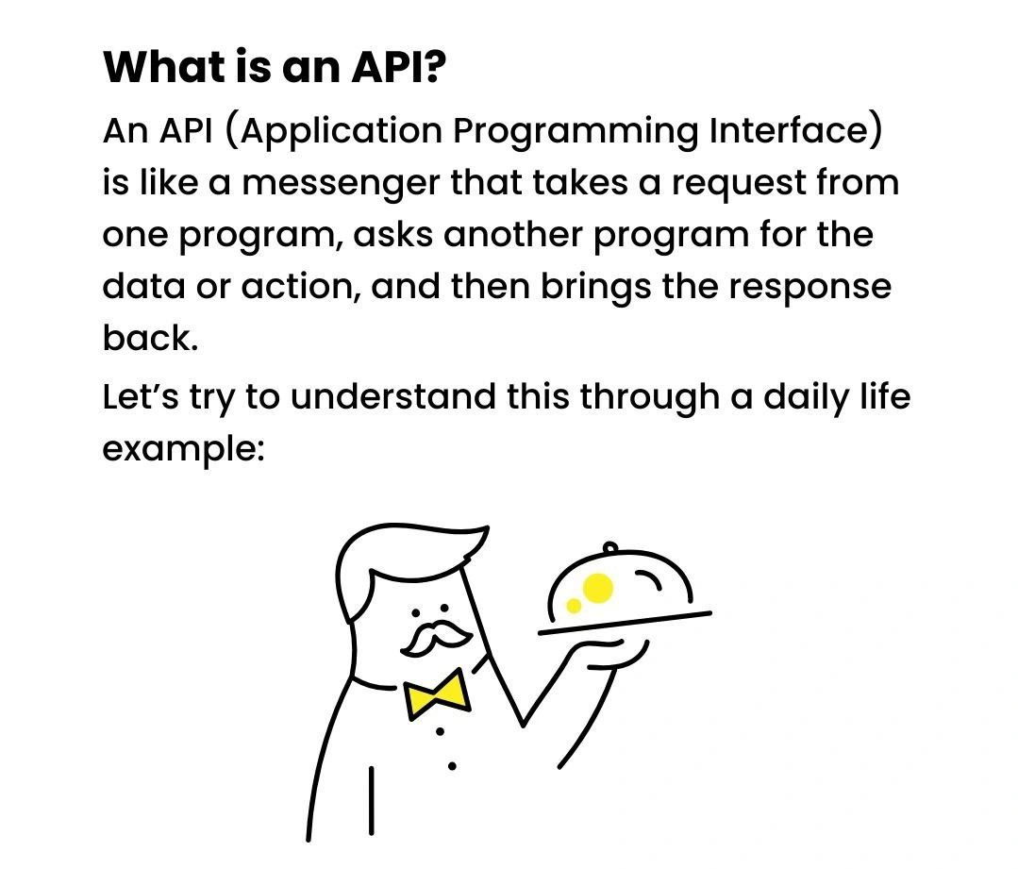

Slide 8
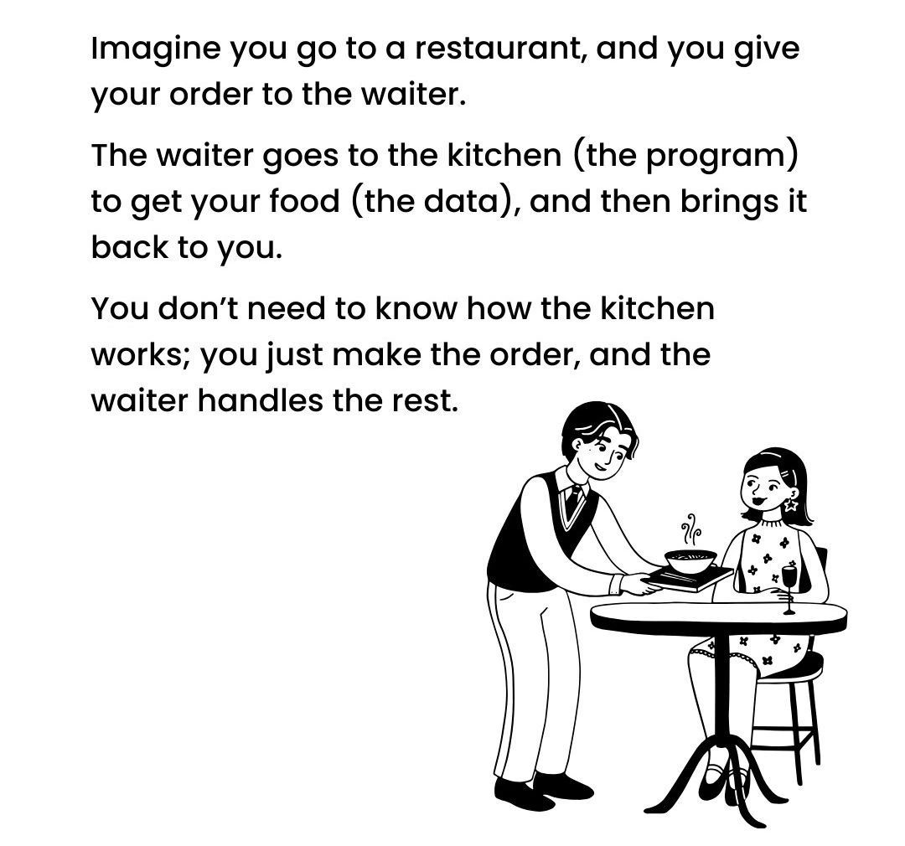

Slide 9
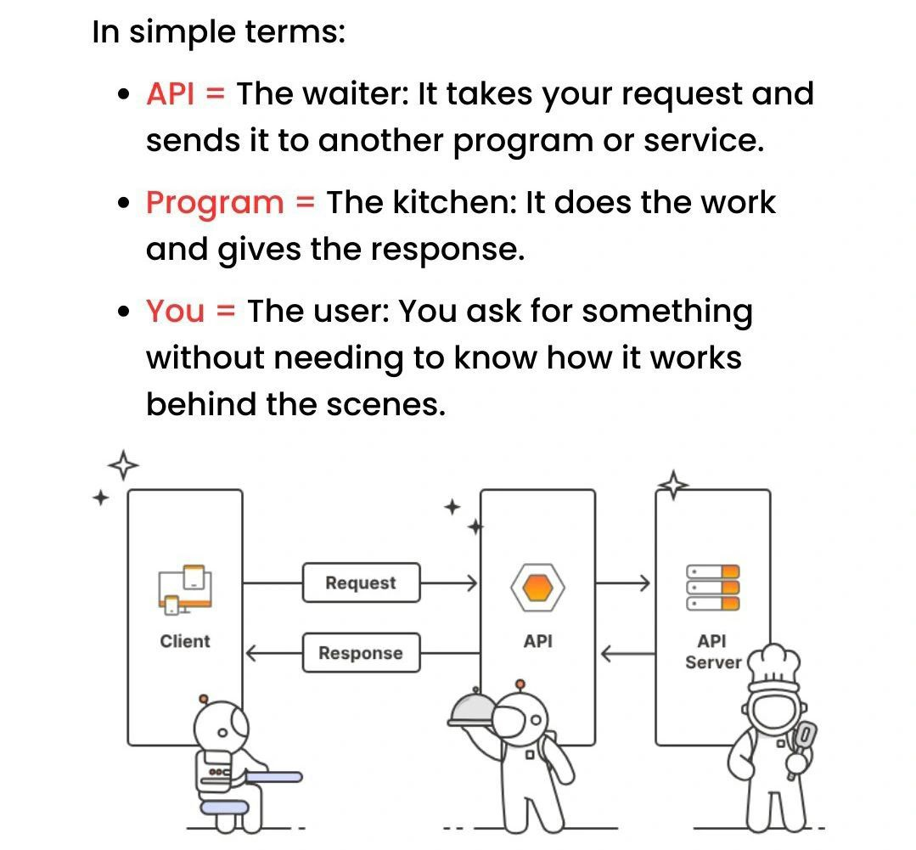

Slide 10
Example for API (with Security and Access Control):
Let’s say our college has a central Database that stores all important information such as:
Student records (marks, attendance, personal details)
Professor details (pay slips, schedules)
Examination data
Administrative data (college finance, notices, etc.)
⚠️ Problem:
If we give direct access to this database, anyone could see or change sensitive data, leading to security breaches and data misuse.

Slide 11
Solution: Use an API
Instead of giving direct database access, we create an API which adds set of rules and regulation to access the data such as:
Controls who can access what
Protects sensitive information
Allows only authorized users to perform specific actions
User Role | What They Can Access via API
Student | Only their own marks, attendance, profile
Professor | Their own schedule, pay slips
Management | Full access to college data for reports & decisions

Slide 12
How it works:
A student logs into the college portal and requests to view their exam results.
The portal sends a request to the API, including the student’s ID and proper authentication (like a login token).
The API checks who is making the request (student, professor, or management) and what data they’re allowed to access.
The API fetches only that student’s marks from the database — not anyone else's.
The API then sends the result data back to the portal in a structured format (usually JSON).
The portal displays the marks to the student securely.

Slide 13
Types of APIs:
REST API (Representational State Transfer): Uses HTTP requests like GET, POST, PUT, PATCH and DELETE.
SOAP API (Simple Object Access Protocol) – Uses XML messaging
GraphQL API – Allows clients to request only the data they need.
WebSocket API – Used for real-time communication.

Slide 14
REST API (Representational State Transfer)
Common and simple way to talk to web services.
Uses HTTP requests like GET, POST, PUT, PATCH and DELETE.
SOAP API (Simple Object Access Protocol)
An older and more strict way of sending messages between systems.
It uses XML to send data, and it follows strict rules.
Example:
Like filling out a government form – everything has to be exact and formal.

Slide 15
3. GraphQL API – Allows clients to request only the data they need
Let's the client ask exactly what data it needs, nothing more, nothing less. This avoids getting too much or too little data.
Example: Like ordering a custom sandwich — you pick exactly what you want in it.
4. WebSocket API – Used for real-time communication
Used for real-time, two-way communication between client and server.
Once connected, both can send/receive messages instantly without needing to ask again and again.
Example: Like a phone call — both people can talk and listen at the same time, in real time.

Slide 16

REST API:
REST (Representational State Transfer) is a web service that follows REST principles to enable communication between client and server or 2 systems.
REST is an architectural style for designing networked applications. It relies on a stateless, client-server, cacheable communications protocol -- the HTTP protocol is most often used.

Slide 17
Why the Name REST?
The name "REST API" comes from the acronym "REST," which stands for Representational State Transfer. REST is an architectural style and set of constraints for building networked applications, particularly web services.
Here's a breakdown of the components that make up the name:
Representational: REST uses resources (such as data or objects) and their representations to interact with web services. A resource can be anything that can be named, such as a document, image, or database record. These resources are represented in a format that can be processed by the client, such as JSON or XML. Between XML and JSON, JSON is popular because it can be easily converted to JavaScript Object.
State: In REST, the state of the resource at any given point in time is transferred between the client and server. The client holds the current state of the interaction, and any changes to the state are sent to the server in a stateless manner. This means that each request from the client must contain all the necessary information for the server to understand and process it.
👉 The server does not store any client context between requests — every request is independent.
Transfer: The transfer refers to the exchange of these Representations between the client and server over a network, usually using the HTTP protocol. The client sends requests to the server, and the server responds with the resource representations.
Protocol: Set of Rules and Regulations for Data Communications.

Slide 18
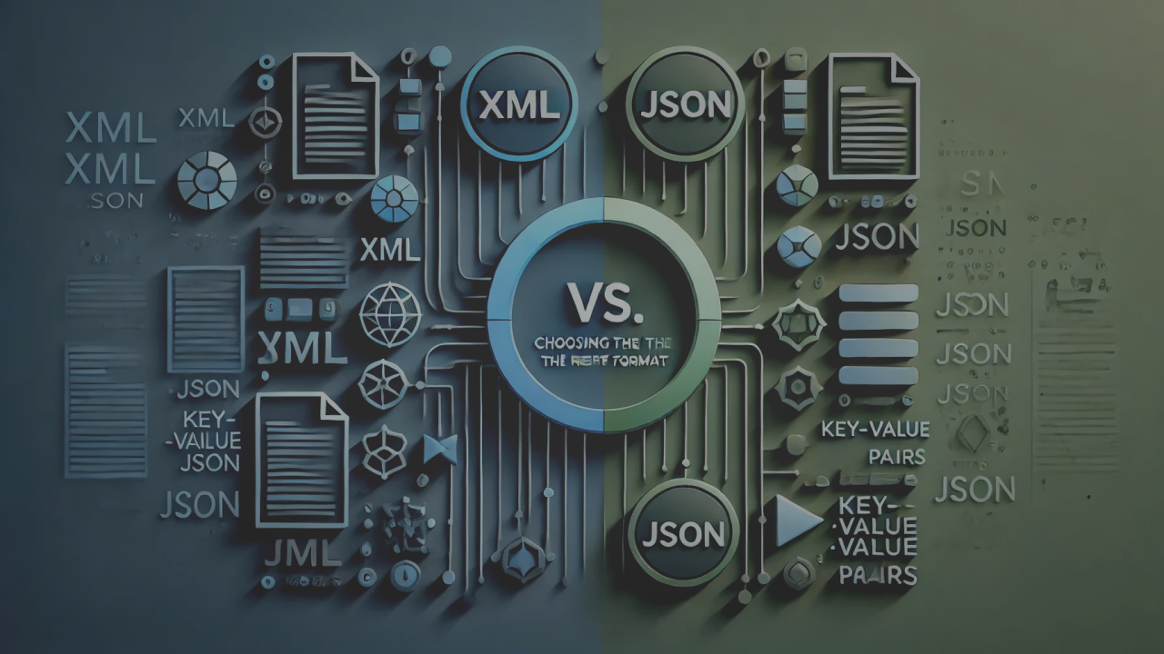

Slide 19
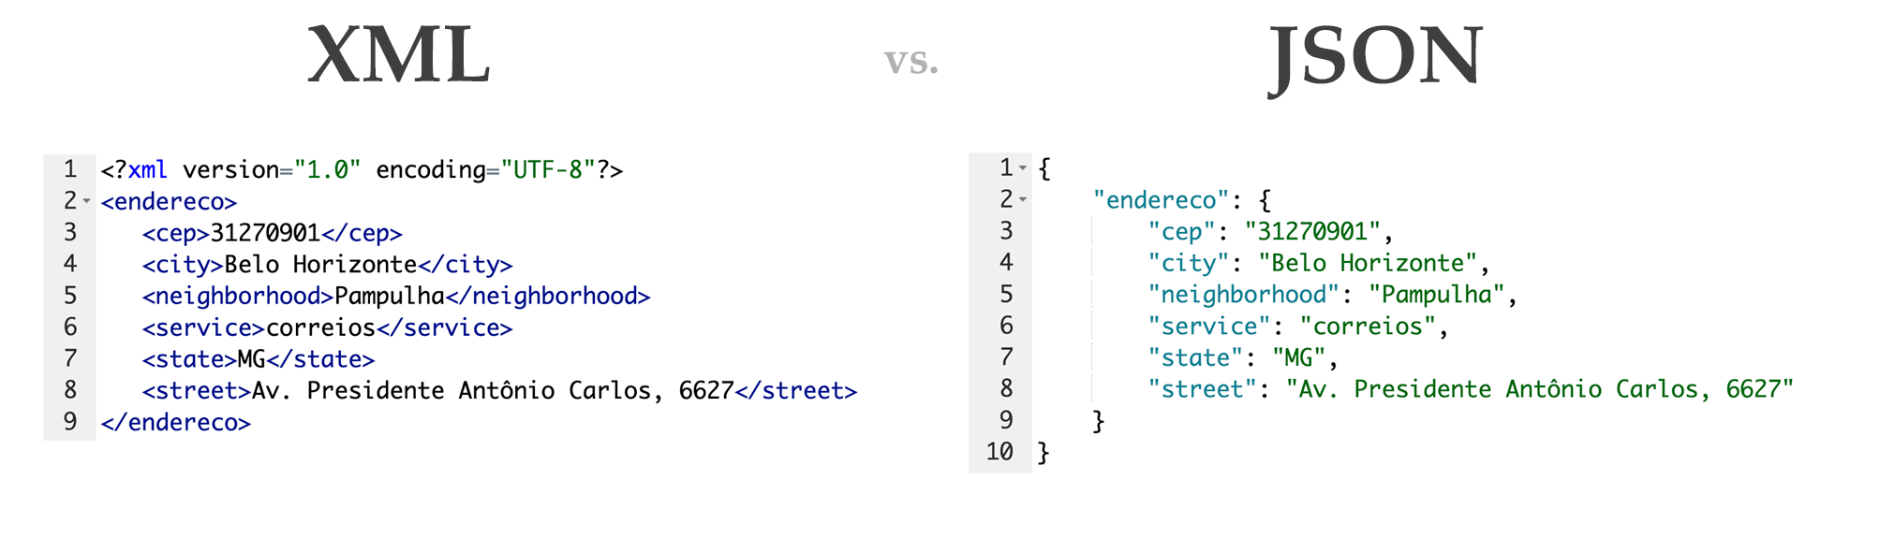

Slide 20

HTTP (HyperText Transfer Protocol):
HTTP is an application-layer protocol used for communication between web browsers (clients) and web servers. It defines how messages are formatted and transmitted over the internet, and how web servers and browsers should respond to various requests.
HTTP itself is a protocol, which means it already defines a set of rules (standards) for how communication happens between client and server.

Slide 21
Core Rules/Protocols of HTTP
Client–Server Rule
Communication always happens between a client (e.g., browser, mobile app) and a server (website/server).
The client sends a request, and the server sends a response.
Statelessness
Every HTTP request is independent.
The server does not store session information by default.
If needed, cookies, sessions, or tokens are used to maintain state.
Request–Response Format
Request = Method + URL + Headers + Body (optional)
Response = Status Code + Headers + Body (optional)

Slide 22
4. HTTP Methods Rule
Defines what kind of action the client wants:
GET → Read data
POST → Send new data
PUT → Update data
PATCH → Partial update
DELETE → Remove data
5. Status Codes Rule
Server must respond with a code showing result:
1xx → Informational
2xx → Success (200 OK)
3xx → Redirection (301, 302)
4xx → Client errors (404 Not Found, 403 Forbidden)
5xx → Server errors (500 Internal Server Error)

Slide 23
6. Headers Rule
Both request and response can have headers containing extra information:
Example: Content-Type, Authorization, Cache-Control, User-Agent.
7. Content Representation Rule
Data sent in HTTP must follow MIME type standards (e.g., text/html, application/json, image/png).
MIME type (Multipurpose Internet Mail Extensions type) is a standard way to describe the nature and format of a file or data being transmitted over the internet.

Slide 24
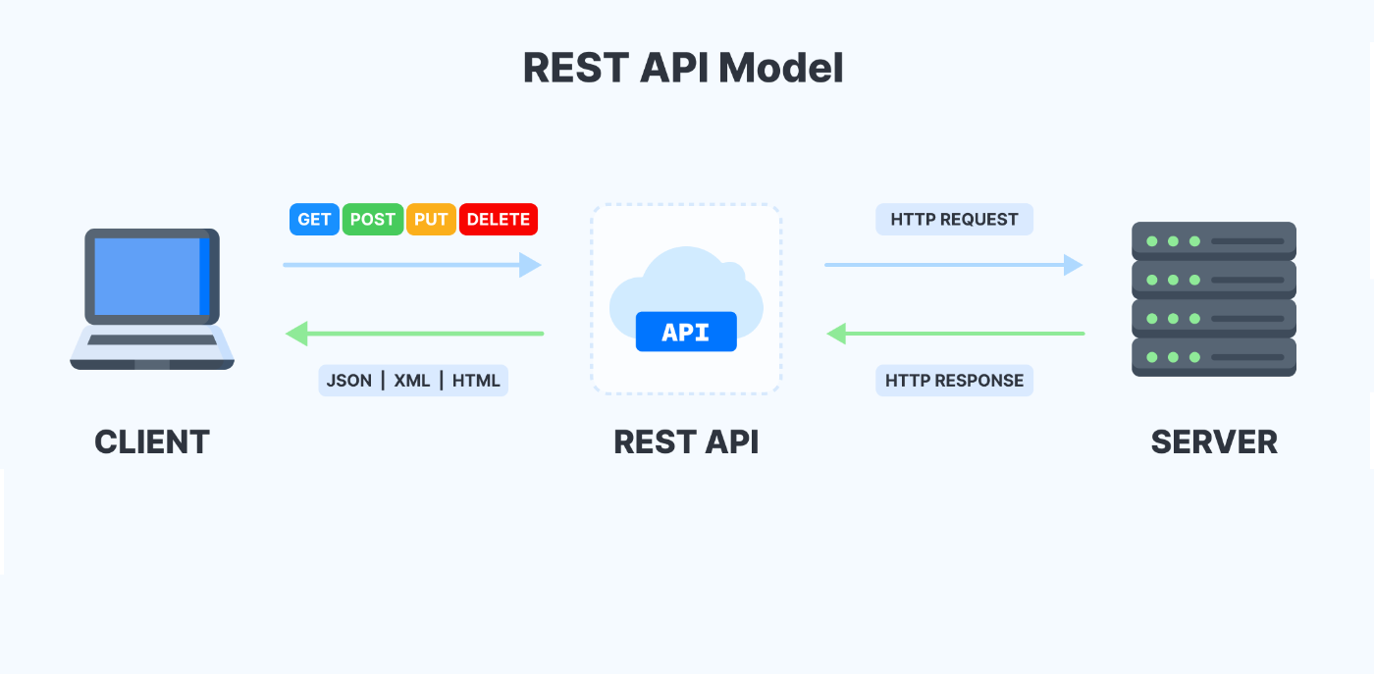
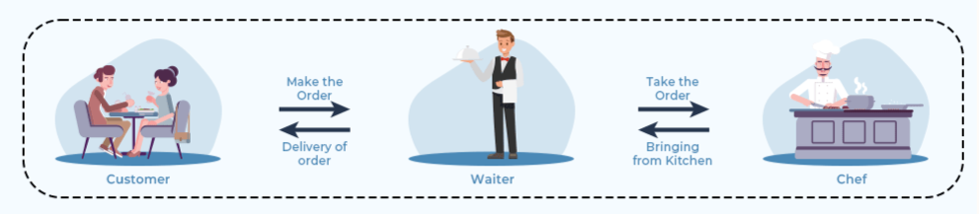

Chef

Slide 25
Principles or Constraints of REST:
Statelessness: The Server does not store state; instead, each request carries all the necessary information.
Client-Server Architecture: The client (like a browser or app) asks for data, and the server sends it — both work separately.
Cacheability: Some responses can be saved (cached) so the client doesn’t have to ask the server again and again.
Uniform Interface: All requests follow the same rules and format, making communication easy and consistent.
Layered System: The client doesn't need to know how many steps or layers the request goes through to reach the server.
Code on Demand (Optional): The server can send extra code to the client to make it smarter or do more things.

Slide 26
Why is it called REST?
The name comes from the idea that:
"Representational" → The client interacts with representations of resources (e.g., JSON, XML).
"State Transfer" → The state of the resource is transferred between client and server using HTTP methods (GET, POST, etc.).
Breaking it Down:
Representation → When a client requests a resource, the server sends a representation of that resource (e.g., JSON response for user data).
State Transfer → The Server does not store state; instead, each request carries all the necessary information.

Slide 27
Traditional Web Servers:
In the traditional web server model, each client request is handled by a separate thread or process. This can lead to scalability issues when handling large number of concurrent connections, as each thread or process consumes system resources.
The traditional web server model can be inefficient and resource-intensive, especially for I/O bound applications that spend a significant amount of time waiting for I/O operations to complete. This can lead to poor performance and scalability issues.
🔴 The Problem with Thread-per-Request
Threads are heavyweight: they consume memory and CPU
If 1000 users connect at once, the server might try to spin up 1000 threads 🧵🧵🧵… leading to:
High resource consumption
Slowdowns or crashes
Poor scalability

Slide 28
How do multiple threads seem to run at the same time?
The operating system uses a technique called context switching.
It rapidly switches between threads within milliseconds.
So while only one thread runs at a time on a single core, it feels like multiple threads are running simultaneously.
Example: If the CPU switches between 10 threads every 1 millisecond, to a human, it looks like all threads are running at once.

Slide 29
Limitations of Traditional Web Servers:
1. Thread-Based Handling:
Model: Traditional servers spawn a new thread or process for each incoming connection.
Limitations:
High memory consumption as each thread/process requires a dedicated memory space.
Increased CPU overhead when managing thousands of threads.
Poor scalability when handling a large number of concurrent connections.
2. Blocking I/O Operations:
Nature: Many traditional servers use a blocking I/O model, where a thread waits for disk or network operations to complete. This thread cannot do anything else during that time.
Impact:
Wastes server resources by keeping threads idle.
Reduces overall throughput for applications requiring high concurrency.
Slower response times for I/O-heavy workloads.

Slide 30
3. Resource-Intensive:
Traditional web servers tend to consume significant memory and CPU resources due to their multi-threaded or multi-process model.
These servers struggle with modern web use cases like real-time data streaming and APIs with high traffic.
4. Latency in Handling Requests: (FIFO Job Scheduling Algorithm)
Due to synchronous execution, servers can face delays:
A time-consuming request can block subsequent ones.
Requests are often queued while waiting for resources to become available.
5. Lack of Real-Time Capability:
Traditional web servers were not optimized for real-time, bidirectional communication:
WebSockets and real-time streaming (e.g., chat apps, live updates) are difficult to implement.

Slide 31
6. Complexity in Handling Asynchronous Tasks:
Traditional web servers are primarily designed for synchronous request-response models.
Managing multiple I/O tasks asynchronously often requires additional libraries or workarounds.
7. High Overhead for Small Requests:
For lightweight or frequent requests (e.g., APIs or microservices), creating and managing threads introduces overhead.
This makes the server inefficient for use cases requiring high-frequency, low-latency responses.

Slide 32




Traditional Web Server Model:
The Traditional Web Server Model is based on a thread-per-request or process-per-request architecture, which has been widely used in servers like Apache HTTP Server.

Slide 33
What is the Event Loop?
The event loop is a core concept in asynchronous programming in Python, especially when using libraries like asyncio. It allows the execution of asynchronous tasks (coroutines) without blocking the main thread. Instead of waiting for a task (like an I/O operation) to complete, the event loop can switch to other tasks, making it possible to run multiple operations concurrently.
Event loop waits for and dispatches events or messages in a program. It works by making a request to some internal or external “event provider” (that generally blocks the request until an event has arrived), and then it calls the relevant event handler (“dispatches the event”).

Slide 34
Dining Philosophers:
Event loop is a solution to a classic logical problem “Dining Philosophers”:
Five silent philosophers sit at a round table with bowls of spaghetti. Forks are placed between each pair of adjacent philosophers.
Each philosopher must alternately think and eat.
However, a philosopher can only eat spaghetti when they have both left and right forks.
Each fork can be held by only one philosopher and so a philosopher can use the fork only if it is not being used by another philosopher.
After an individual philosopher finishes eating, they need to put down both forks so that the forks become available to others.

Slide 35
The Dining Philosophers Problem, as described in our example, is a classical synchronization problem in computer science that deals with resource sharing and avoiding Deadlocks. In the context of Python's event loop, the relationship lies in how resources (like forks in the philosophers' analogy) are managed efficiently, ensuring non-blocking behavior and avoiding conflicts (e.g., deadlocks or starvation).
Key Concepts in the Dining Philosophers Problem
Philosophers represent tasks or coroutines.
Forks represent shared resources.
Philosophers alternate between thinking (non-blocking tasks) and eating (blocking tasks requiring resources).
Philosophers must acquire both forks (resources) before eating, ensuring that access to resources is synchronized.

Slide 36
How the Event Loop Works:
Task Scheduling:
The event loop takes care of scheduling and running tasks (coroutines).
When you define an async function (a coroutine), it doesn't run immediately. Instead, you create a "task" that will eventually be scheduled for execution by the event loop.
Running the Event Loop:
The event loop is started by calling asyncio.run(). This starts the event loop, and it keeps running until all scheduled tasks are completed.
The event loop runs in a single thread, but it can handle multiple tasks concurrently by switching between them, especially if they are waiting for I/O operations.

Slide 37
3. Coroutine Execution:
When a coroutine calls an await expression, it yields control back to the event loop, allowing other tasks to run while waiting.
When the awaited operation completes (e.g., a file read, network request, or timer), the event loop resumes the coroutine from where it left off.
4. Blocking and Non-blocking:
If a task is waiting on I/O like reading data from a file or making a network request, it will be paused, and the event loop can execute other tasks.
Without the event loop, tasks would be executed sequentially, meaning the program would be stuck waiting for one task to complete before starting another.

Slide 38
Example for Event Loop in terms of Number of User Request:
👥 Scenario: Multiple Clients Sending Requests
Suppose 3 users (Client A, B, C) make requests to your Node.js server.
Example request: GET /data — this fetches data from a file or database.
🧠 What Happens Internally?
🧾Clients send requests:
Client A → GET /data
Client B → GET /data
Client C → GET /data
These arrive almost at the same time or concurrently.

Slide 39
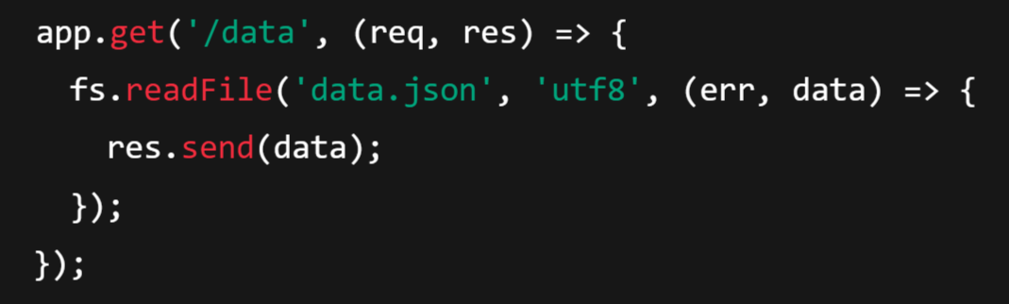
2. Backend receives the requests
Each request is handled in the main thread, which is running the Event Loop.
Example:

Slide 40
3. I/O operations are offloaded to libuv’s thread pool
fs.readFile() is asynchronous
So the actual file reading is offloaded to a worker thread via libuv
This does NOT block the main thread
Meanwhile, the event loop continues listening for new incoming requests
This allows Node to handle thousands of requests without creating thousands of threads.
4. Worker threads do the heavy lifting
Each file read happens in the background:
Client | Request | Thread Handling
A | /data | Worker Thread 1
B | /data | Worker Thread 2
C | /data | Worker Thread 3

Slide 41
5. When I/O is done, callback is queued
Once the file is read:
The callback (res.send) is pushed to the Event Queue
Event Loop checks if V8 is idle
If yes, the callback is executed
6. Event Loop executes the callback
Callback is run in the main thread
res.send(data) sends back the response to the client
Now Client A, B, C get their data — without blocking each other!

Slide 42
Analogy
Imagine 1 waiter (main thread) in a restaurant:
3 customers place orders at once
The waiter doesn’t cook — he sends each order to the kitchen (worker threads)
While the kitchen prepares, the waiter is free to take more orders
When food is ready, the waiter serves it one-by-one

Slide 43
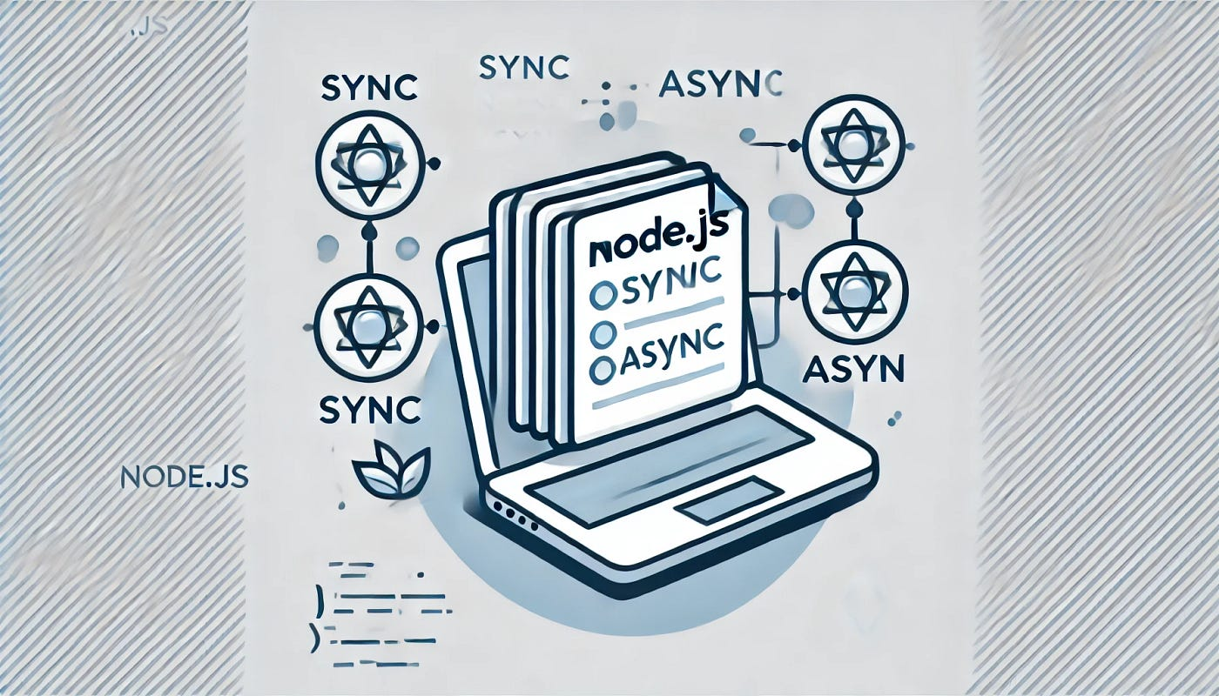
Synchronous & Asynchronous Tasks

Slide 45



Slide 46
Functioning Of Ports
A port always functions along with an IP address. An IP address is a numeric address that acts as an identifier for a computer or a device on a network.
For communication purposes, each device needs to have an IP address. An IP address and a port number work in sync to exchange data on a network.
🔚 Final Conclusion:
A domain (or IP address) like localhost or example.com identifies a machine (or server).
But a machine can run multiple services/servers at the same time.
To distinguish between these different services on the same domain/IP, each must listen on a unique port number.

Slide 47
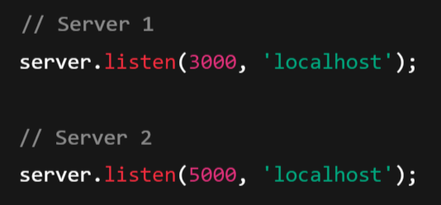
📌 Example:
Suppose you run two servers on your machine:
Now you can open:
http://localhost:3000 → Connects to Server 1
http://localhost:5000 → Connects to Server 2

Slide 48
What’s Happening Here?
localhost (or 127.0.0.1) is the same host/IP address.
The port numbers (3000 and 5000) are different — so your OS knows which server to talk to.
Each port acts like a different communication channel.
How Does the Operating System Handle This?
When a request comes in, the OS uses the port number to decide which application it should be sent to.
🔑 The IP address tells your computer: “Hey, this message is for you.”
🔑 The port number tells your OS: “Hey, this message is for the Node.js server running on port 3000 — not Chrome or MySQL.”

Slide 49
Final Analogy
Your PC = Apartment building
IP address = Building address
Ports = Apartment/room numbers
Servers = People living inside
All residents live in the same building, but to reach a specific one, you need the correct room (port) number.

Slide 50
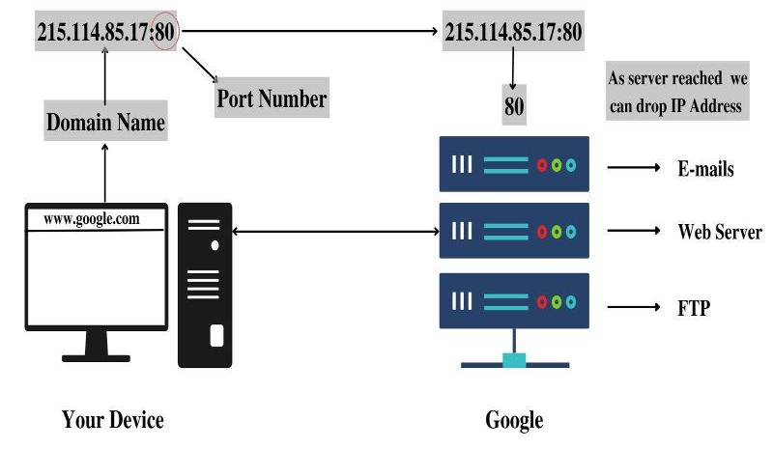
Now in simple terms, what does this all mean?
So as an example, let's take a very common port that just about everyone uses every day and that is port number 80. Port 80 is associated with HTTP which are web pages so whenever we visit a web page from our computer, we're using port 80.

Slide 51
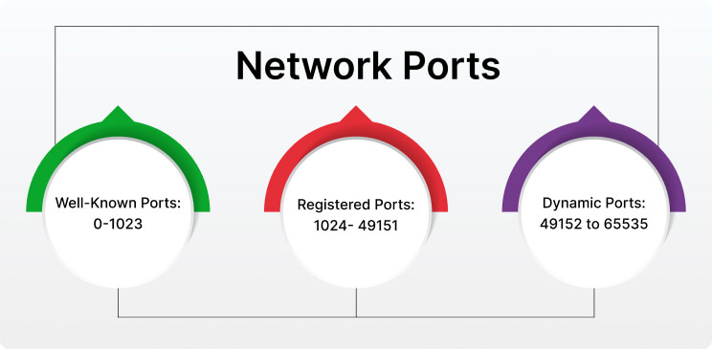
🔢 Port Number Ranges in Networking
In total, port numbers range from 0 to 65535 (16-bit unsigned number 2 pow 16). These are divided into 3 main categories:

Slide 52
1. Well-Known Ports (0 – 1023):
Also called system ports or privileged ports
Reserved for standard services and protocols
Typically require admin/root access to bind a server to them
❗ Don't use these for your local development servers unless you know what you're doing.
Port | Used By
20 | FTP (File Transfer Protocol – Data)
21 | FTP (Control)
22 | SSH (Secure Shell)
23 | Telnet
25 | SMTP (Mail)
53 | DNS (Domain Name System)
80 | HTTP (Web)
443 | HTTPS (Secure Web)

Slide 53
2. Registered Ports (1024 – 49151):
Also called user ports or semi-reserved ports
Can be used by user applications or custom servers
Most commonly used for web development, APIs, etc.
Examples:
3000, 5000, 8080, 4000 are popular for local dev servers
✅ Perfect range for our Node.js, React, Python, or other local dev apps.

Slide 54
3. Dynamic / Private Ports (49152 – 65535):
Also called ephemeral or temporary ports
Assigned automatically by the OS when a client makes a network request
Not used for servers, but for temporary client-side connections
Example: When your browser requests google.com, your OS picks a port from this range to send the request.

Slide 55
What is utf-8:
UTF-8 (Unicode Transformation Format - 8-bit) is a character encoding standard that encodes all characters in the Unicode character set. It is widely used for text files and data transmission over the internet because it supports a vast range of characters while being efficient in storage.
The Unicode character set is a universal standard for encoding, representing, and handling text in virtually all languages and scripts. It assigns a unique code (known as a code point) to every character, symbol, or emoji, regardless of the platform, program, or language.
Note: A character encoding standard defines a system to represent text (characters) as binary data that computers can process. Every character is assigned a unique code, which is then converted into binary numbers. This enables computers to store, transmit, and render text from different languages and scripts.

Slide 56
What is Unicode:
Unicode is a universal character encoding standard that provides a unique number, known as a code point, for every character, no matter the platform, program, or language. It aims to ensure consistent representation and handling of text across different systems and devices.
Why is UTF-8 Used?
Universal Encoding: UTF-8 supports nearly every character from all languages and symbols, making it universal.
Efficiency: For texts with mostly English characters, UTF-8 is efficient because it uses only one byte per character. For other scripts, it uses additional bytes only when needed.
Web Standard: Most web browsers, APIs, and databases (like MySQL, MongoDB) default to UTF-8 encoding for text.
Cross-Platform Compatibility: UTF-8 ensures consistent representation of text across different systems and programming languages.

Slide 57
Why UTF-8 when we have ASCII:
1. Limited Character Set in ASCII
ASCII:
Supports only 128 characters (7-bit encoding).
Designed primarily for English alphabets, numbers, and some control characters.
Cannot represent characters from other languages like Chinese, Arabic, Hindi, or even additional symbols and emojis.
UTF-8:
Supports over 1.1 million characters (as part of the Unicode standard).
Can encode text from virtually any language or script.
Includes symbols, emojis, and special characters.

